Slide 1


Introduction to Java
Confidential

Slide 2








GUVI,
a proven learning ecosystem
Skilling using English & vernacular languages
Incubated by IIT-M and IIM-A
Acquired by HCL Group
600+
Corporates
3M+ learners

Slide 3
Introduction
Java is an object oriented programming language. It has syntax similar to C and C++ languages, but has vastly improved features.
Java is platform independent.
Java platform provides a complete environment for application development on desktops and servers and for deployment in embedded environments.

Slide 4
Java, a Programming Language developed by Sun Micro System in the year 1991.
Java was developed by James Gosling, Patrick Naughton, Chirs Warth, Ed Frank and Mike Sheridon.
During the initial period Java was called as Oak (from 1991 to 1995).
Java’s direct predecessor are C and C++
Java developed using the syntax from C and object oriented concepts from C++.

Slide 5
Java is object oriented, it supports all the OOPS characteristics. This makes java application easy to develop and maintain.
Java is portable and platform independent - The feature Write-once-run- anywhere makes the java language portable provided that the system must have interpreter for the JVM.
Java is Secure, It does not use memory pointers explicitly. Security manager determines the accessibility options of a class like reading and writing a file to the local disk.
Java is robust , Java provides support for error checking at compile time and dynamic checking at runtime.
Java supports multi threading to enhance performance.
Java supports automatic memory management – Refers to memory allocation and reclaiming for Java objects.

Slide 6
.
The following are the Java frameworks,
Java SE - Java Platform, Standard Edition or Java SE is a widely used platform for programming in the Java language. This is the Java Platform used to deploy portable applications for general use. In practical terms, Java SE consists of a virtual machine, which is used to run Java programs, together with a set of libraries.
Library Examples: java.lang.*, java.net.*, jav.io.*, java.util.*.
Java EE - Java Platform, Enterprise Edition or Java EE is a widely used platform for server programming. The applications developed using JEE stack can be deployed in N tier fashion in appropriate application servers and remotely accessed.
Examples: EJB, Servlet, JSP, JSF , JMS etc.

Slide 7
.
Java ME - Java Platform, Micro Edition, or Java ME, is a Java platform designed for embedded systems such as mobile devices
, PDA etc. Target devices range from industrial controls to mobile phones and set-top boxes.
Examples: Connected Limited Device Configuration (CLDC), Mobile Information Device Profile (MIDP), Information Module Profile (IMP).

Slide 8
What happens after you develop a Java Code?
Java Code is compiled and converted to a byte code rather than a native code.
English is an language which can understood by many people across the world. Similarly byte code is a format that can be run in many platforms Unix, Windows, Linux and also irrespective of hardware's.

Slide 9
What is Java SDK?
SDK stands for Software Development Kit is a package used for developing java applications and converting the java code to Byte codes. The conversion is typically done using Java compilers.
What is JRE?
JRE stands for Java runtime environment is used for executing java applications . It converts the java byte code to the necessary native code based on the underlying platform.
There are different JRE versions for different platforms such as Linux, Windows, Unix etc.

Slide 10
The Java applications can be classified as follows,
DDaass BBiilldd kkaannnn zzuurrzzeeiitt nniicchhtt aannggeezzeeiiggtt wweerrddeenn..
Java stand alone applications – These are typically GUI programs, command line java program that execute on a desktop computer and perform the desired functionality independently All they need is a JVM installed in desktop for execution.
Java web applications -These are typical applications that are built using combination of technologies such as EJB, JSF and servlets etc. These are deployed in an application server (or) web server. They are accessed using a web browser such as Fire Fox , IE. They are examples of N tier applications.

Slide 11
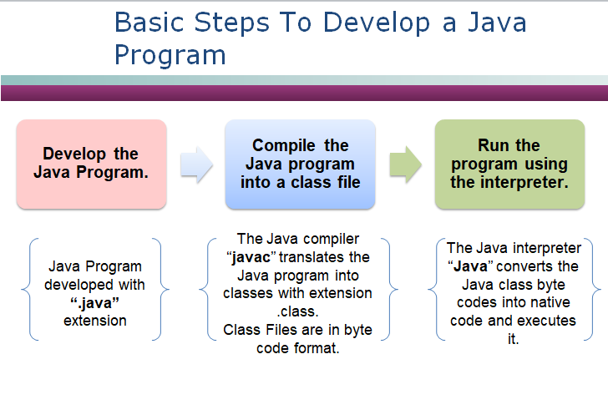

Slide 12
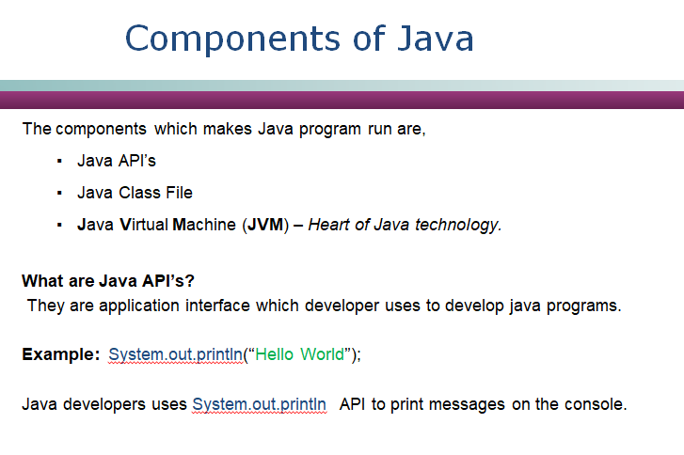

Slide 13
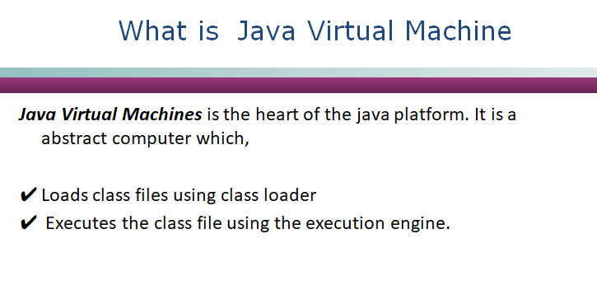

Slide 14
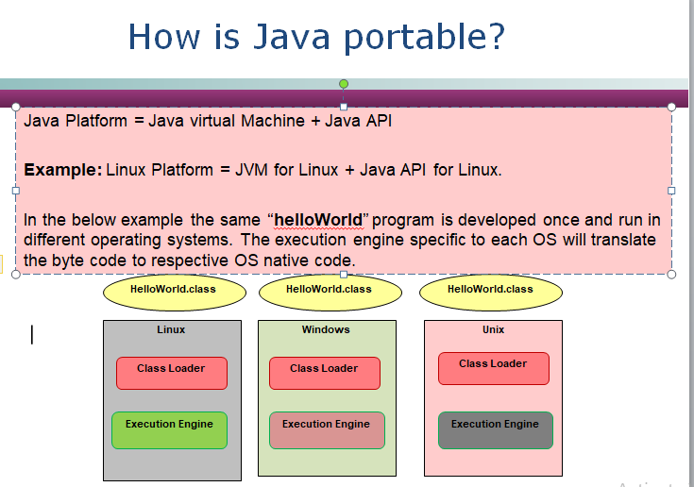

Slide 15
Create a folder “JavaWorks” in D or C drive.
Open notepad and type the following program in the notepad.
class HelloWorld{
public static void main(String []args){
System.out.println(“Hello World”);
}
}
Save the notepad file with the file name HelloWorld.java.
IMPORTANT NOTE: The file should be saved under the same name as of the class name.

Slide 16
Open a command window, type CMD in command window.
Set the path and class path variable.
What is Path?
Path represents the folders to be searched for running the java or javac commands.
Needed for compiling Java program.
How to set path: set path =c:\java 1.5\bin; %path%
Where %path% - To ensure that the new path is appended with existing path variables set.
NOTE: Assuming Java home is c:\java.

Slide 17
What is class path?
Class path is the path where the class and Java API’s are loaded. Needed for executing class files.
How class path is set: set classpath = c:\java\jre\lib; %classpath%;
Where %classpath% - To ensure that the new class path does not to override the existing class path variables set.
NOTE: Assuming Java home is c:\java.

Slide 18
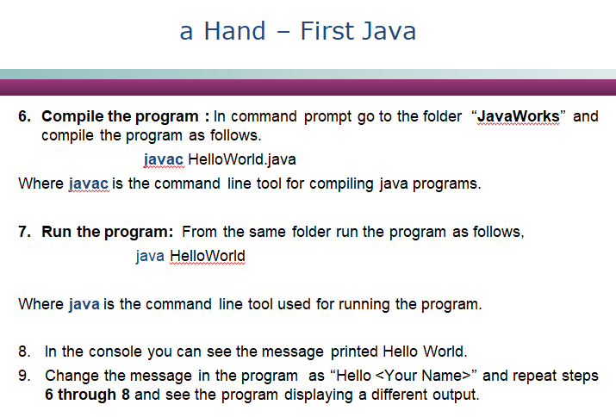

Slide 19
The main method is the starting point of any java application. Any java application to be executed using “Java” command needs a class with main method.
The application cannot run without a main method.
Once the Helloworld.class file is executed, the interpreter searches the main method and invokes it.
Syntax:
You will learn more about the access specifiers and method arguments in the subsequent sessions.
Public static void main(String [] args)
{
// The program implementation
//goes here
}

Slide 20
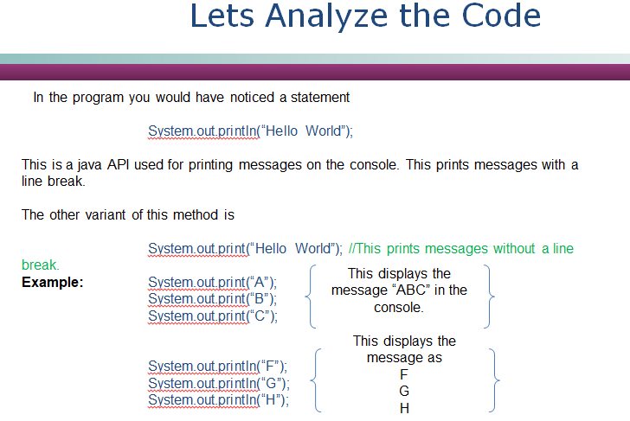

Slide 21
Hands On Exercise
Develop the following program using notepad,
Create a Java program with a main method and save it as “FirstProgram.java” in the “JavaWorks” Folder.
The Java program needs to print the following message (in brown & green color font) in the specified format in the console.
******** This is My First Java Program ********
********This is a demo on print ************
NOTE: The green and brown color text should printed using separate print statements.
Hint: Use print statement to display green and brown text message in the same line. Use println for introducing a line break.
Open a new command window and execute the program.
Compile the program

Slide 22
Classes are the fundamental building blocks of a Java program. Java application are built using one or more java classes, a class contains data and application business logics.
Data are represented as variables in classes.
Application business logic are implemented as methods in classes.
•A class is a blue print for making objects.
Classes Example: Employee, Department
NOTE:
A single physical .java file can have more than one classes.
The java file should be named after the class which is declared public.
There cannot be two classes defined as public in the same java file.

Slide 23
The Structure of the class is as follows,
class <Class Name>
{
This is the class declaration.
// The class implementation goes here
This is the class body implemented within the curly braces
}
The body of the class contains,
Variables – This is a container for storing class data.
Methods – Application behavior implemented and this changes the data (variables values).

Slide 24
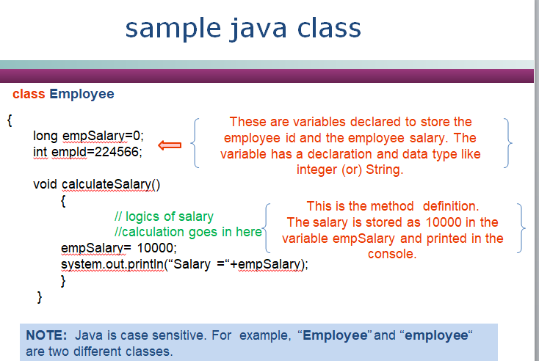

Slide 25
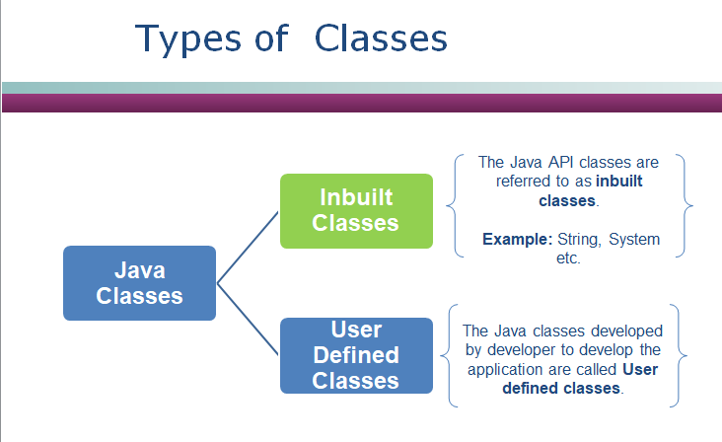

Slide 26


Packages are used for logically grouping the classes together into a single unit.
In the Java API, classes are grouped into packages.
Das Bild kann zurzeit nicht angezeigt werden.
Das Bild kann zurzeit nicht angezeigt werden.
Example:
USA
India
Both the apple looks similar, If you mix the apples you will end up with a confusion to differentiate the varieties. The box where they are placed helps us to differentiate them.
Similarly though the java classes have the same name using the packages (box) where they reside the classes can be differentiated and used.

Slide 27
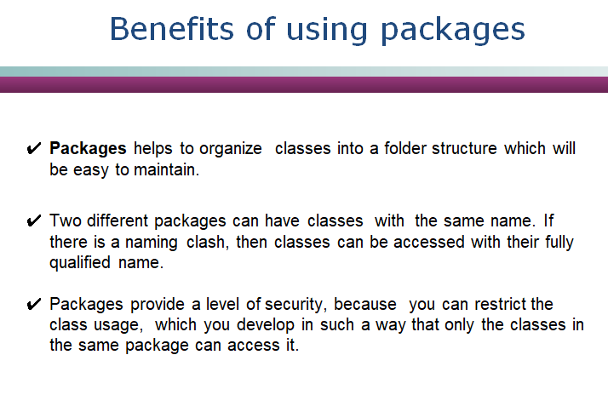

Slide 28
DDaass BBiilldd kkaannnn zzuurrzzeeiitt nniicchhtt aannggeezzeeiiggtt wweerrddeenn..
How to create a Package:
Use a “package” keyword to create packages.
Syntax:
package<package name>;
Where, package name is name of the package were the class should be place. This line should be placed as the first line of the program.
Example: package com.hcl
NOTE: When compiling a java class with a package the compiler will create a The folder structure similar to the package defined.
Example: A java file Book.java under com.hcl. Package after compilation will generate a Book.class under com→hcl folder.

Slide 29
DDaass BBiilldd kkaannnn zzuurrzzeeiitt nniicchhtt aannggeezzeeiiggtt wweerrddeenn..
How to import a Package:
Use “import” keyword to import a package.
Java includes the import statement to bring certain classes, or entire packages, into visibility.
Syntax:
import <package-name>.<class-name>;
(or)
import <package-name>.*;
Where, package- name and class-name is name of the package and class to be imported respectively.
The second * option imports all the classes under the specified package. This line should be placed as the second line of the program ie. after package definition.
Example: import com.hcl.Book; (or) import com.hcl.*

Slide 30
package com.hcl.books; public class Book{
void displayName()
{
System.out.println(“Java Book”);
}
}
package com.hcl.libraries; import com.hcl.books.Book; class Library{
public static void main(String args[])
{
Book book = new Book(); book.displayName();
}
}
How it Works?
The class book will be defined inside package “com.cognizant.books”.
For the Library class to use the Book Class it needs to import the Book class as “import com.cognizant.books.Book;”
•NOTE: Import not needed if the Library class is in the same package “com.cognizant.books”.

Slide 31
How to compile?
javac –d . Library.java
where –d denotes the destination directory for the compiled classes.
. Represents the current directory.
How to execute the class?
java com.hcl.library.Library
The class needs to be executed using the absolute package name.

Slide 32
Object creation is a three step process,
Declaration - Giving a name to the object to be created.
•
Instantiation - The new keyword and constructor creates a instance of the object.
Initialization -The values will be initialized using the constructor.
You will learn more about the constructors and objects in the next sessions.

Slide 33
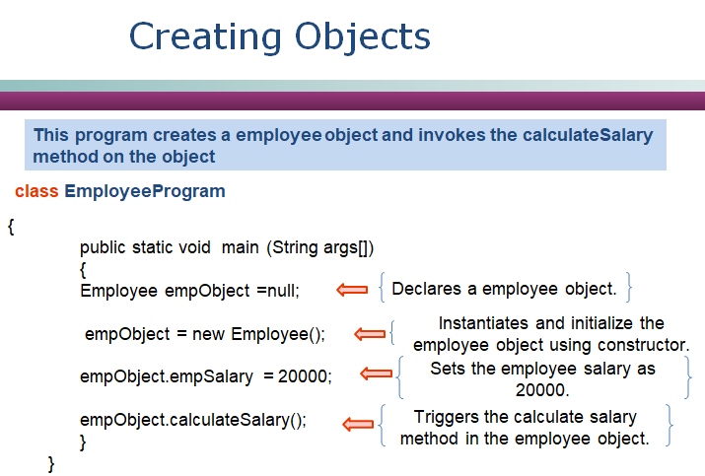

Slide 34
Activity– Creating Objects
1. Create a java class “Student” add a integer variable “registrationId”.
Create a method “displayReistrationId” which will print the “registrationId” of the student in the format
“The student registration id is <Registration Id>”
Create a java class “StudentMain” add a main method which will
Create a object instance of the Student class
Set the registration id to value “1290”
Invoke the method ““displayReistrationId””.
The message needs to be displayed in the console.
Expected Output: “The student registration id is 1290”

Slide 35
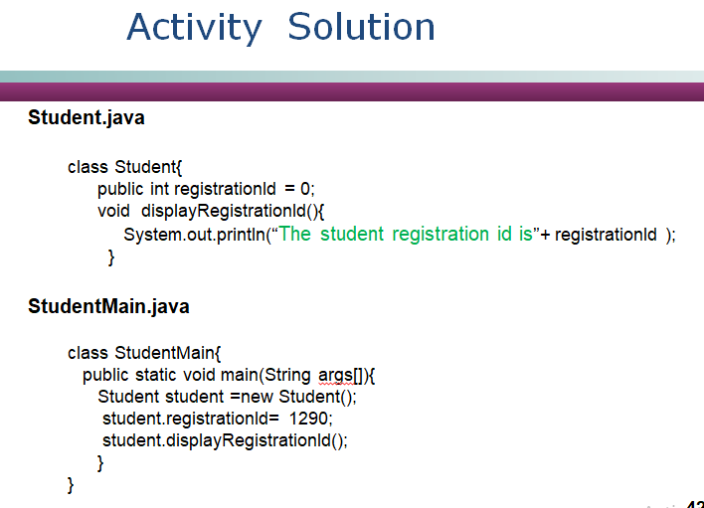

Slide 36
Associates to reflect the following topics before proceeding.
How can java class be logically grouped?
What are the benefits of java packages.
What is the keyword used for creating objects?.

Slide 37
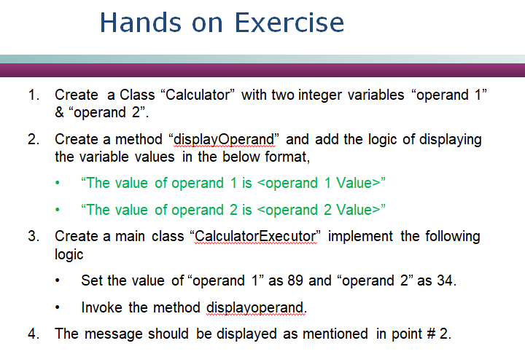

Slide 38
Thank You!

